Slide 1
What is science?
Max Brown
Material taken from Sean Carroll

Slide 2
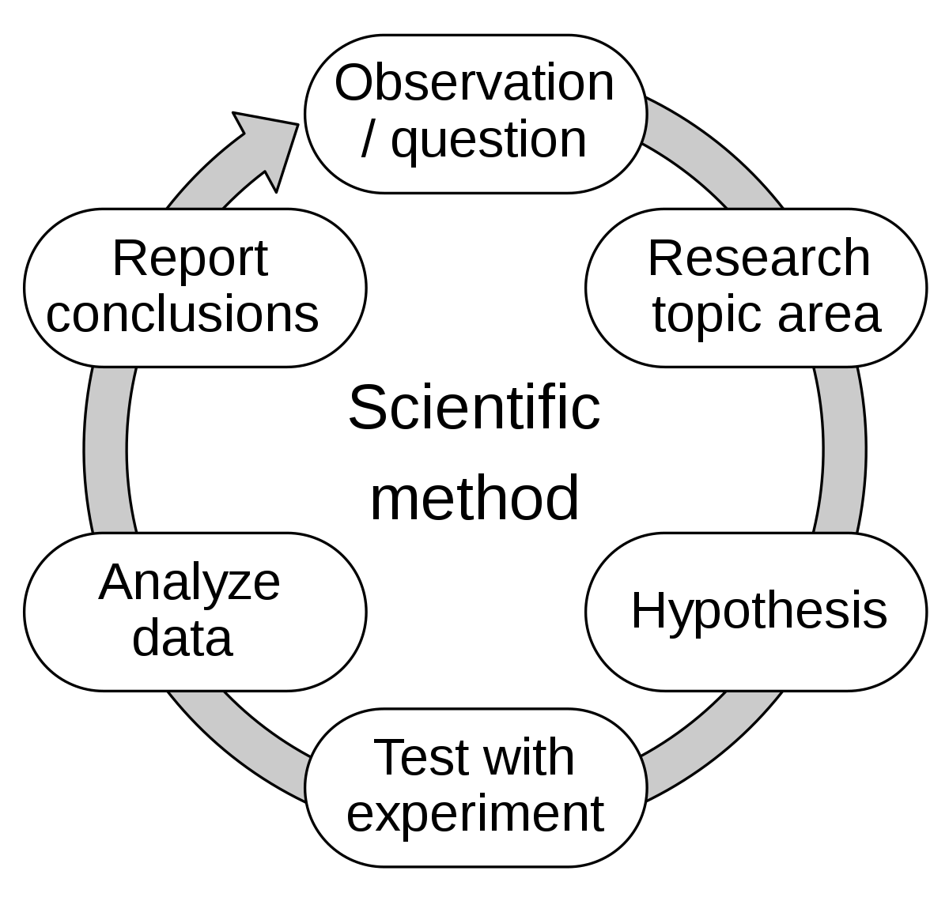
The Scientific method from Wikipedia. Equivalent to a middle school textbook.
Science can be defined as a way of learning about the natural world that is based on evidence and logic.
Middle school textbook
Science is long process that includes systematic observation, measurement and experiment. It is then followed by formulation, testing and modification of hypotheses.
Science book for kids

Slide 3
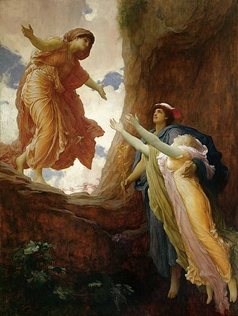
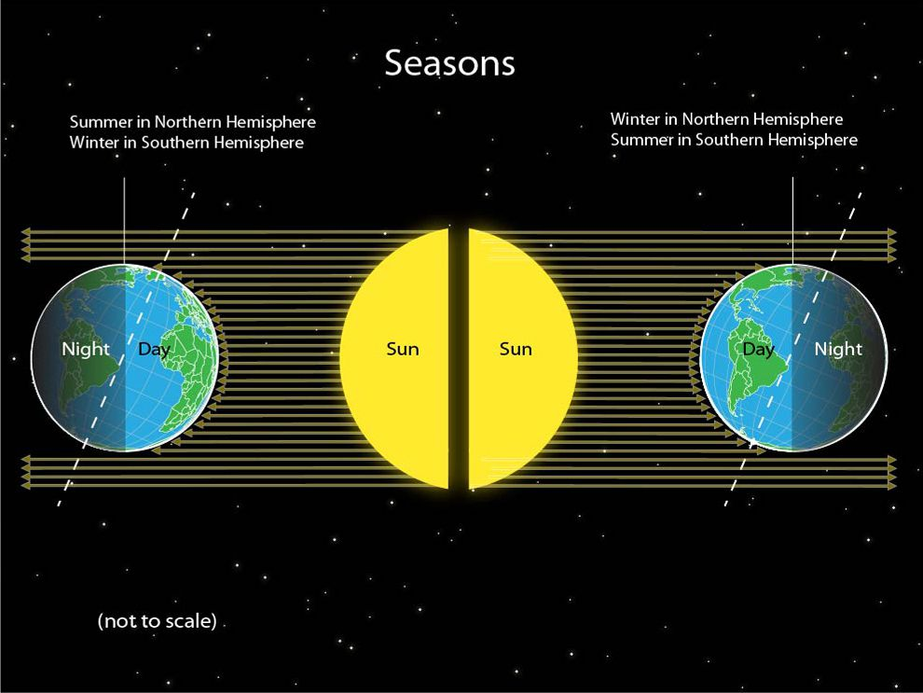
Why are there seasons?
The Return of Persephone by Frederic Leighton
National Geographic

Slide 4
Sean Carroll’s Definition of Science.
Think of every possible way the world could be. Label each way an “hypothesis.”
Look at how the world actually is. Call what you see “data” (or “evidence”).
Where possible, choose the hypothesis that provides the best fit to the data.
{accuracy, simplicity, consistency, scope, and fruitfulness,…}

Slide 5
Empiricism
The key feature of science is that it is empirical — progress is made by comparing multiple plausible theories to actual data — rather than rationalist/logical — deriving truths from reason alone.

Slide 6
Natural vs Supernatural
True or False?
“Science assumes naturalism, and therefore cannot speak about the supernatural.”

Slide 7
Falsifiability?
True or False?
“Scientific theories must make realistically falsifiable predictions.”
String Theory?
Multiverse theory of Quantum Mechanics?

Slide 8
Reproducibility?
True or False?
“Science must be based on experiments that are reproducible.”
Cosmology- the history of the Universe

Slide 9
True or False? Science is “what scientists do.”

Slide 10
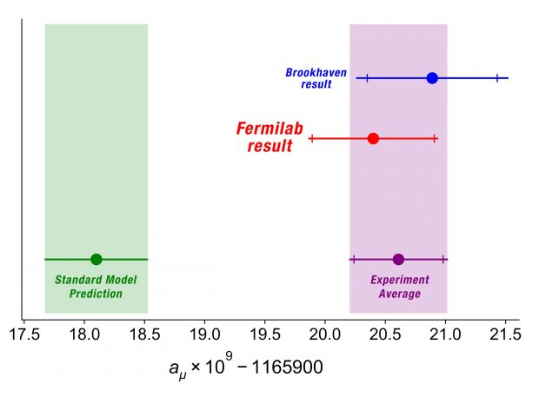
G-2 data

