Slide 1
Laboratory Safety
Presented by Max Brown
Modified from Brandon Ernest

Slide 2
What are some common lab hazards that are uncommon outside a physics lab?
Lasers – Blindness or Burns
Chemicals/Radiation – Poisoning
High voltages – Shock or Fire
Gases – Asphyxiation
Extreme heat or cold – Burns

Slide 3
What does laboratory fire safety mean to you?
What are your responsibilities when it comes to fire safety in the lab?
What are common hazards you find in the labs?
Laboratories are kept clean and well maintained
Equipment is maintained
Chemicals stored appropriately
Students are given safety training
Everyone wears proper PPE
Safety checks performed before each class
Chemicals left out, not in storage cabinets
Fume hoods full of unused equipment, supplies, etc.
Extension cords
Aisles and exits blocked
Safety equipment blocked or missing
Inadequate PPE or inappropriate clothing such as open toed shoes
Notes:
Start by going around the room and asking the first question. Get the person’s name and say, “[Name]” what is your responsibility for fire safety in the lab?”
Once everyone has answered, reveal the responsibilities and discuss with the class.
Move onto the second question and repeat process but this time let people just give answers without going one-by-one.

Slide 4

What are the consequences if we don’t take responsibility for our student’s safety?
UCLA Lab Fire
Lab graduate employee Sheharbano "Sheri" Sangji was performing procedures with a pyrophoric (air reactive) chemical when it was somehow exposed to the air. The chemical ignited and caught Sangji’s clothing on fire in the process. She was not wearing any PPE and had not been trained on the proper method of executing the procedure. She died after 18 agonizing days in the burn ward.
Where does the responsibility lie?
Chemistry professor Patrick Harran was charged with four felony counts of willfully violating state occupational health and safety standards, the first time criminal charges were brought against someone for a laboratory death. He later plead out for $10,000 fine, teach inner-city schools for 5 summers and perform over 800 hours of community service
Notes:
Read synopsis of UCLA lab fire and ask the question. Once students give thoughts, reveal consequences for the professor charged with crimes.

Slide 5
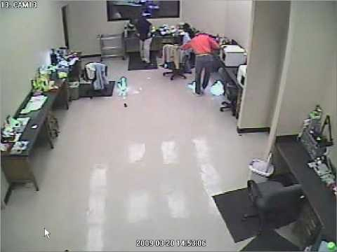
A comedy of errors… if is wasn’t so scary
How many unsafe acts can you count?
Notes:
Switch from more serious issue to a comedic scene.
Let students watch video and then discuss what is happening and what the employees are doing wrong.
Looks like flammable metal catching fire
Employees move towards the fire – never do this, always move away from the fire, it can get worse fast
Employees try to put out the fire with hands and feet – again, never do this. Your hands and feet are not fireproof as far as I know
Kicking the fire items is actually spreading the fire to other parts of the room, very dangerous
The lady actually catches her shoe on fire
No one pulls fire alarm or attempts evacuation

Slide 6
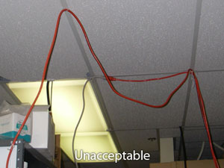
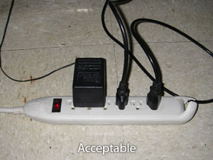
Recognize common lab fire safety violations
Extension Cords
Extension cords – never allowed to be used as permanent wiring
Always plug directly into the wall outlet or into surge protected power strip
Notes:
Heating and cooling equipment or high draw appliances must always be plugged into the wall outlet.
Never daisy chain surge protectors.

Slide 7
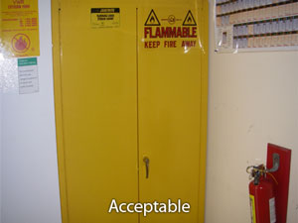
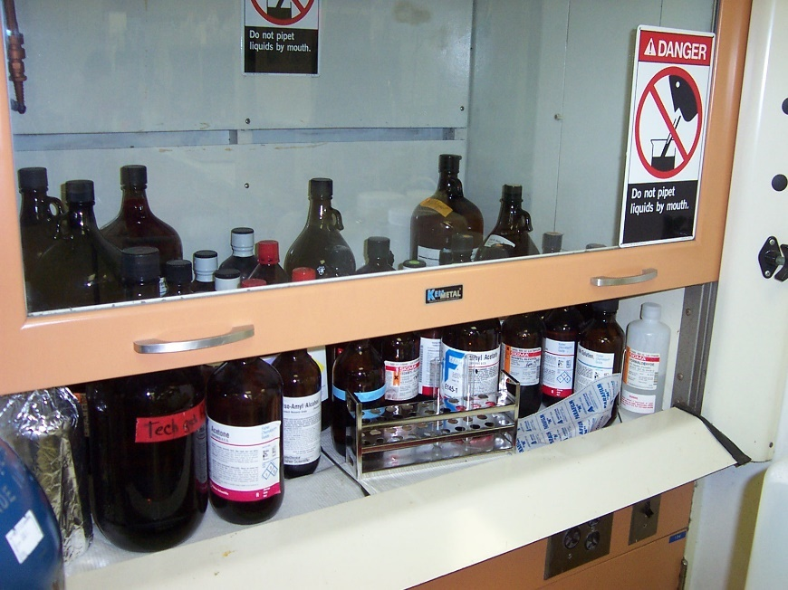
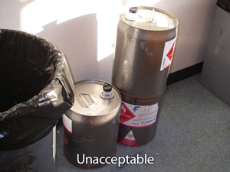
Recognize common lab fire safety violations
Incorrect Storage of Chemicals
Chemicals not currently in use MUST be stored in approved cabinets.
Never store containers on the floor, on countertops, or in the fume hood.
Unacceptable
Notes:
Chemicals can be knocked over, spilled, etc.
Containers can block egress or safety equipment

Slide 8
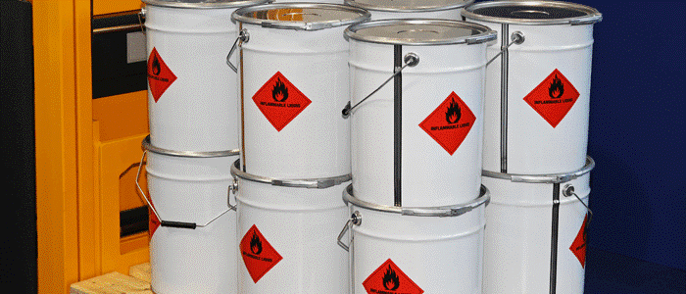
Recognize common lab fire safety violations
Excessive Flammable Liquids for Space
Flammable liquids have maximum amounts that can be stored or used based on the laboratory size.
Maximum amount of flammable liquids is 5 gallons per 100 ft²
Can be doubled if kept in approved storage cabinets
Notes:
Contact EHS to find out how much flammable storage your lab is allowed.

Slide 9

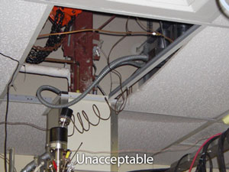
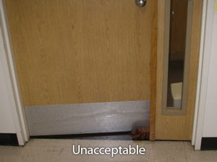
Recognize common lab fire safety violations
Ceiling Tiles Missing or Doors Propped Open
Ceilings are designed to trap smoke and hot gases from fires so that sprinklers and/or detectors can activate. Open doors allow fire to quickly move outside the room of origin.
Notes:
Contact facilities if you need ceilings fixed.
Never use anything to prop your door open. If temperature is an issue, request facilities to correct the HVAC issues.

Slide 10
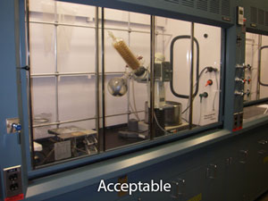
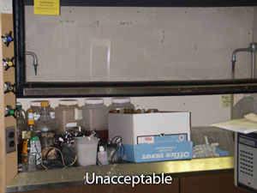
Recognize common lab fire safety violations
Incorrect Use of Fume Hoods
Fume hoods must have inspection tag attached & passed testing
Use sash at correct height
Fume hoods are NOT for storage
Notes:
Fume hoods are designed to mitigate the exposure from toxic fumes, fires, and explosions that can occur during procedures.
Non-working hoods or hoods with incorrect sash heights will not protect you from these incidents.
Excessive chemicals in the hood become a dangerous fire and toxic smoke hazard.

Slide 11
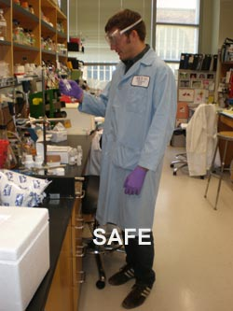
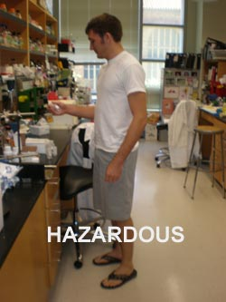
Recognize common lab fire safety violations
Not Wearing PPE
Every time you or your students step into the lab, they must be wearing appropriate PPE
Lab coats, eye protection, gloves, hair back, closed toe shoes, no shorts
- Helps prevent burns
Protects eyes from explosions
Wear natural fibers
Close lab coat
Notes:
Proper PPE is critical to lab safety. Never let anyone into your lab, even for short amounts of time, without proper PPE.

Slide 12
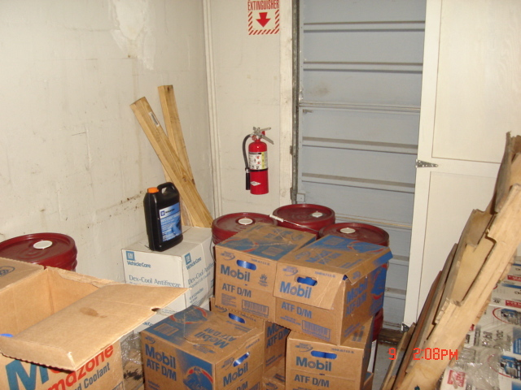
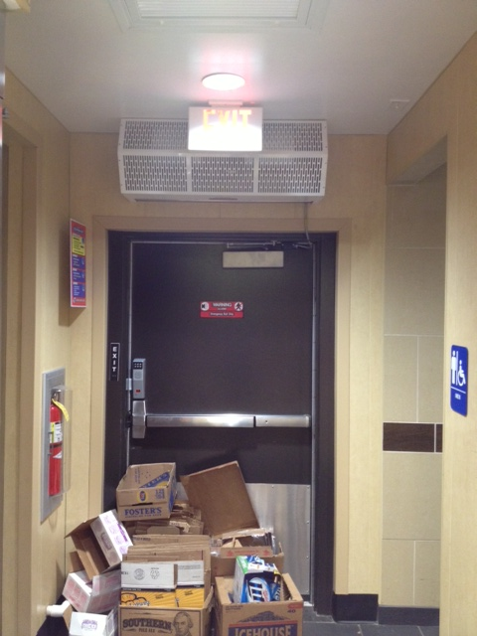
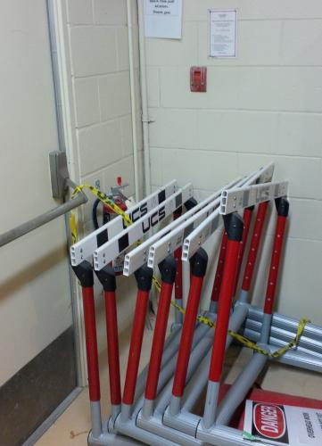
Recognize common lab fire safety violations
Blocking Exits, Aisles, & Safety Equipment
Exits and pathways must be available at a moment’s notice. You don’t want to have to move yesterday’s shipment to get out of the room in a fire emergency.
This one hits the trifecta
Blocked exit
Blocked fire extinguisher
Blocked pull station
Unacceptable
Unacceptable
Unacceptable
Notes:
Never blocking essential safety equipment and exits is one of the most important daily checks you should be making.
Don’t make the mistake of thinking it will be OK if you leave something for just a little while – we don’t schedule emergencies!
Even items like roller carts take precious seconds away from someone trying to get out or pull the alarm.

Slide 13
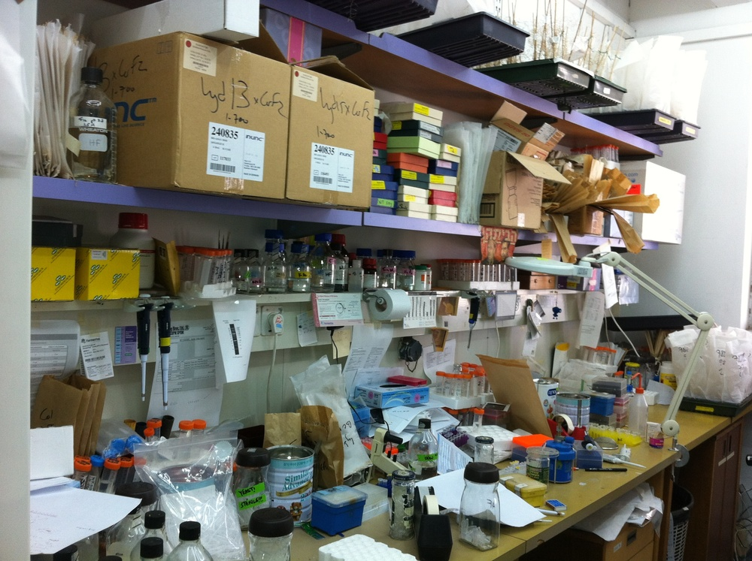
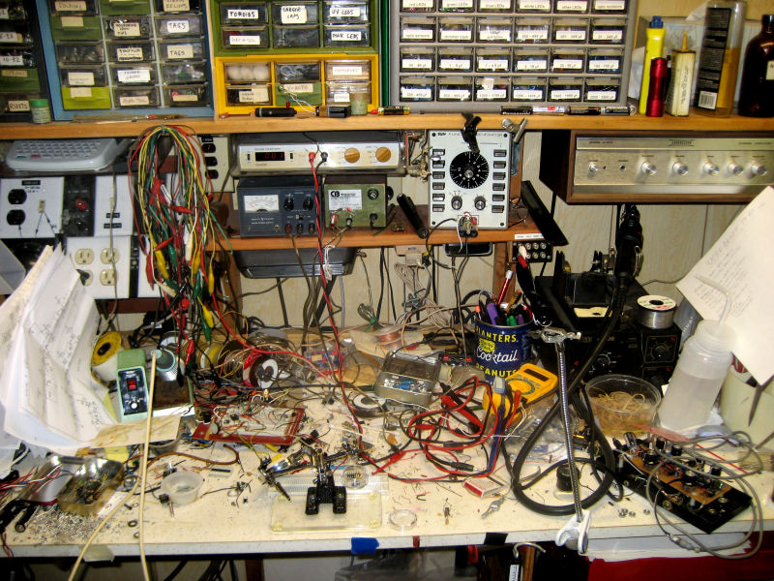
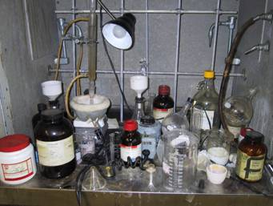
Recognize common lab fire safety violations
#1 Cause of Lab Fires & Accidents
Can anyone guess what it is?
Poor Housekeeping Practices
Notes:
Poor housekeeping practices lead to nearly every other fire safety infraction. Messy, cluttered labs are difficult to work in and often result in spills, broken equipment, blocked egress routes, etc.
When chemicals are strewn all over the place, a small fire can quickly spread to flammable items right next to it. Working cleanly is working safely

Slide 14
If there is a fire in the lab, how should you respond?
Remember RACE
Fire can get out of control quickly, on average it doubles in size every minute.
You are not trained firefighters, evacuation is always the preferred response. It is NOT your job to put out fires in the laboratory.
Notify the proper authorities, Fire Department 1st, UK Fire Marshal 2nd
You must always report a fire to authorities, no matter how small

Slide 15
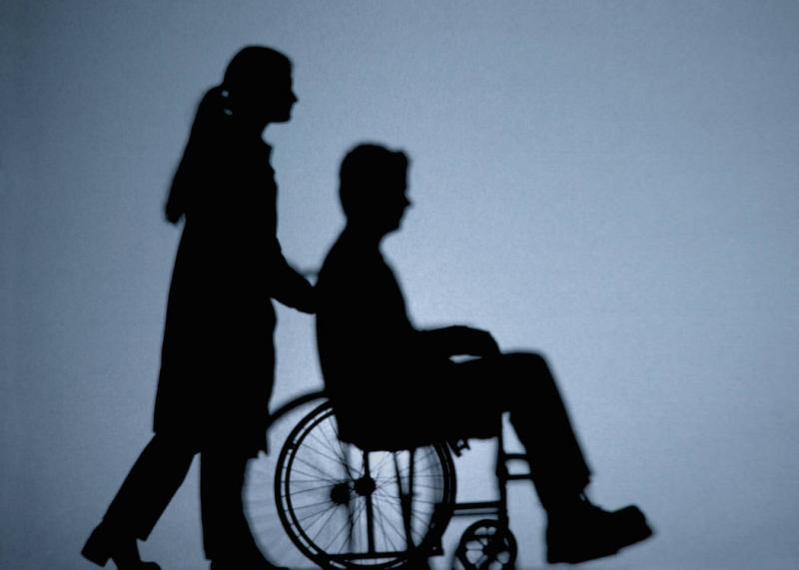
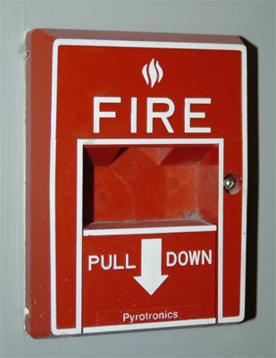
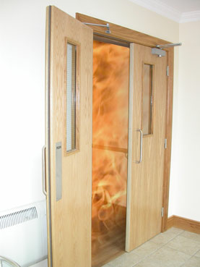
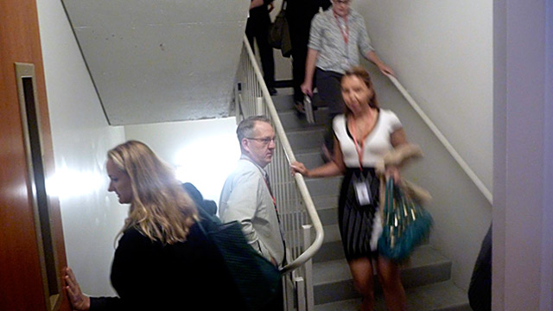
R - Rescue
Assist others
Don’t put yourself in danger
A - Activate Alarm
Pull alarm while exiting building
Call 911 to report fire
C - Confine Fire
Close fume hoods
Shut doors on the way out
E - Evacuate or Extinguish
You MUST EXIT the building
NEVER re-enter the building

Slide 16
Fire Extinguisher Basics
Identify the type of fires found in the laboratory
A
C
Electrical
Electrically energized equipment
Note – If equipment is de-energized, the fire becomes an A classification fire
Ordinary combustibles
Wood, paper, cloth, etc.
B
D
Flammable liquids
Acetone, alcohols, gasoline, solvents
Combustible Metals
Magnesium, Aluminum, etc.
Notes:
Discuss specific items found in labs and what classification of fire they would produce.

Slide 17
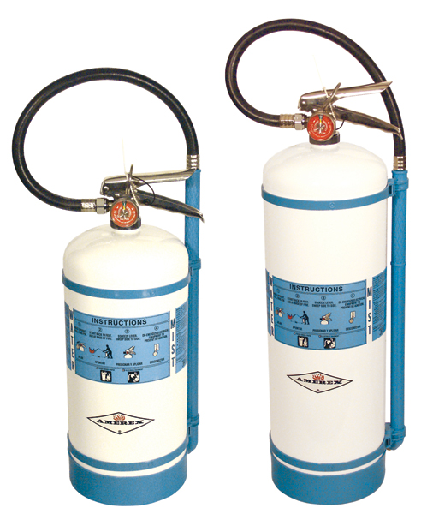
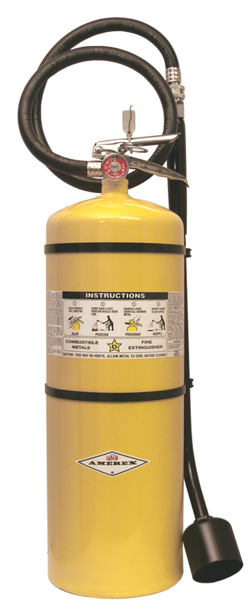
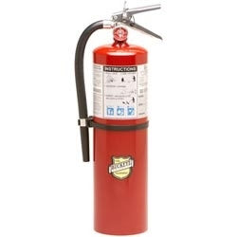
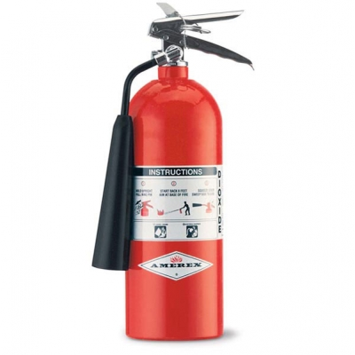
Fire Extinguisher Selection
Choose the correct fire extinguisher for the job
Dry Chemical
A B C
CO2
B C
Flammable Metals
D Only
Water Mist
A B C
Notes:
At this point, I will bring out the different fire extinguishers I have brought for hand-on inspection.
Extinguishers should never be more than 75 ft away from any location in the room.
Talk about the differences between them physically – hoses, nozzle, weight, pressure gauges, etc.
Discuss how they put out fires – ABC uses dry chemical powder to suffocate fire, CO₂ removes oxygen from fire, etc.
Discuss dry chemical, compressed gases (and subtypes), water mist, flammable metal specific
Visual and hands on portion showing each extinguisher, what it looks like, how heavy they are, and the functional parts. Have students handle these individually and state what they see as differences, how to identify.
What type of fire is each type designed to suppress? Slide show with different extinguishers and showing the type of fires they are most appropriate for.
Show videos of how using the wrong type of extinguisher can make the fire worse. Have students discuss why this is.

Slide 18
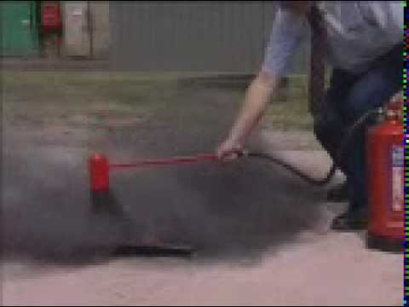
Choose the correct extinguisher for your lab!
No dry chemical extinguishers where flammable metals are used
Compressed gas extinguishers can spread light material fires
Notes:
ABC extinguishers can make flammable metal fires worse or even cause an explosion.
It is very important that you have the correct extinguishers available for the hazards in your particular lab.

Slide 19
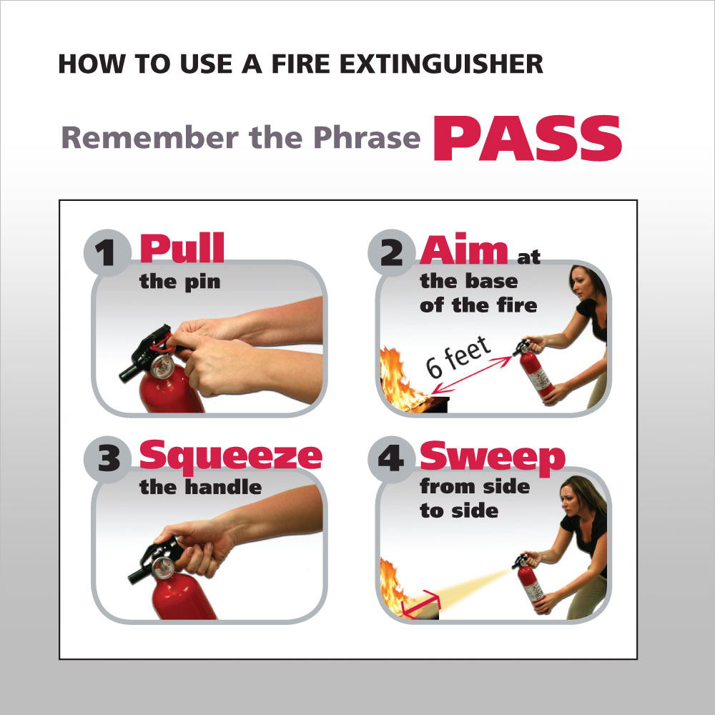
Notes:
Go through this process twice – Talk it through the first time and then perform the actions as you state what they are the second time.

Slide 20
The End
Questions?
Notes:
Students take assessment test and get certificate.

