Slide 1
Harassment and Discrimination
Max Brown
(Modified presentation from Dr. Ankrah and Alina Aleksandrova)

Slide 2
Where to get help:
UK Campus police
https://www.uky.edu/police/
Emergency 911, Non-Emergency (859) 257-8573
“LiveSafe” App
Office of Equity and Equal Opportunity
https://www.uky.edu/eeo/
(859) 257-8927 AskEO@email.uky.edu
Violence Intervention and Prevention Center (VIP)
https://www.uky.edu/vipcenter/
(859) 257-3574 vipcenter@uky.edu
REU director - Dr. Crawford (cbcraw2@g.uky.edu)
Department Chair – Dr. Plaster (brad.plaster@uky.edu)
Associate Chair - Dr. Murthy (murthy@g.uky.edu)
Dr. Brown (max.brown@uky.edu)
Dr. Ankrah (maxwell.Ankrah@uky.edu)
Emergency:
Formal complaints & Investigations:
Trained Confidential Resources
Understand Physics, however
Mandatory Reporters

Slide 3
Outline
Official UK definitions of Discrimination and Sexual harassment
Awkward likely conversations that may or may not be considered as harassment/discrimination
Options to consider
How to protect oneself
When and Where to get help
DEIB-Diversity Equity Inclusion and Belonging

Slide 4
Official UK Definitions
Discrimination: an action or behavior that results in negative or different treatment of an individual based upon race, color, national origin, ethnic origin, religion, creed, age, physical or mental disability, veteran status, uniformed service, political belief, sex, sexual orientation, gender identity, gender expression, pregnancy, marital status, genetic information, social or economic status, or whether the person is a smoker or nonsmoker, as long as the person complies with University policy concerning smoking.

Slide 5
Official UK Definitions
Harassment, a form of discrimination, is unwelcome conduct that is based on the statuses listed. Harassment becomes a violation of University policy when:
The offensive conduct explicitly or implicitly becomes a term or condition of employment or participation in a University activity
The conduct is sufficiently severe, pervasive, or persistent to interfere with an individual’s work, academic or program participation, or creates an environment that a reasonable person would consider intimidating, hostile, or offensive.

Slide 6
Official UK Definitions
Sexual Harassment, a form of sex discrimination, may or may not take place in situations of power differential between individuals involved. Sexual harassment includes unwelcome sexual advances, requests for sexual favors, or other verbal or physical behavior of a sexual nature.

Slide 7
Other forms of Harassment
Quid Pro Quo Harassment
“something given in exchange for something else”
Hostile Work Environment
Degrading Comments
Embarrassing Questions
Sexual Jokes
Bullying
Notes:
Examples of a hostile work environment are the results of:
Degrading Comments
Sexual Propositions
Vulgar Language
Sexual Touching
Embarrassing Questions
Sexual Jokes
Bullying

Slide 8
Awkward Conversations
In the following slides we will present some situations that might not be harassment/discrimination but can lead in that direction.
Some, but not all are experiences from our department.
We will discuss the best way to handle these situations and when you need to involve a higher up.

Slide 9
When a student makes you uncomfortable:
A REU scholar asks you for a date multiple times and does not seem to understand that your polite refusal means you are not interested.
What are some positive ways to respond to this situation?
What are some negative ways to respond that you might accidently choose?
Should this go to the Equity office for a formal investigation?

Slide 10
When a student makes you uncomfortable:
Halfway through the summer you realize your “very funny” friend sometimes says inappropriate jokes that “cross the line.” You know that you have been laughing as others have pointedly left the room. You now feel very uncomfortable.
What are some positive ways to respond to this situation?
What are some negative ways to respond that you might accidently choose?
Should this go to the Equity office for a formal investigation?

Slide 11
When a mentor makes you uncomfortable:
Your research mentor offers to make you first author on a paper if you go on a date with them.
What are some positive ways to respond to this situation?
What are some negative ways to respond that you might accidently choose?
Should this go to the Equity office for a formal investigation?

Slide 12
When a mentor makes you uncomfortable:
A REU scholar regularly wears a “MAGA Hat” or an “Biden Shirt.” More than once a research mentor remarked, “Only an idiot would wear that.”
What are some positive ways to respond to this situation?
What are some negative ways to respond that you might accidently choose?
Should this go to the Equity office for a formal investigation?

Slide 13
Consider Options
Options Result
Ignore Nothing will change or gets worse
Avoid Not possible due to work environment
Talk directly about problem Might get better, or may get worse
Talk to supervisor May be able to help, but will I get labeled a complainer?

Slide 14
Protecting yourself
Avoid jokes, words, phrases and gestures with sexual meaning.
Respect a person’s “personal space”.
Do not respond to seductive behavior.
Respectful behavior facilitates more productive workplace.
Notes:
You can also further protect yourself if you,
Avoid jokes, words, phrases and gestures with sexual meaning.
Respect a person’s “personal space.”
Do not respond to seductive behavior.
Respectful behavior facilitates more productive employees.

Slide 15
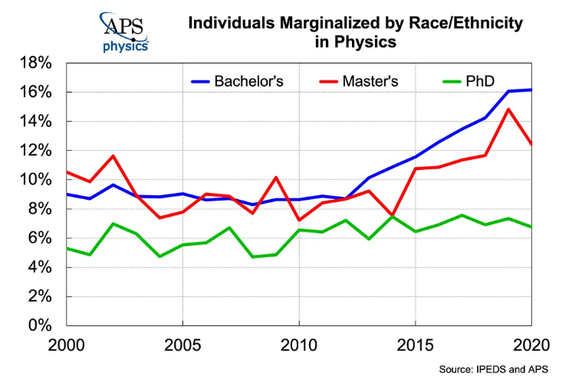
DEIB Diversity, Equity, Inclusion, Belonging

Slide 16
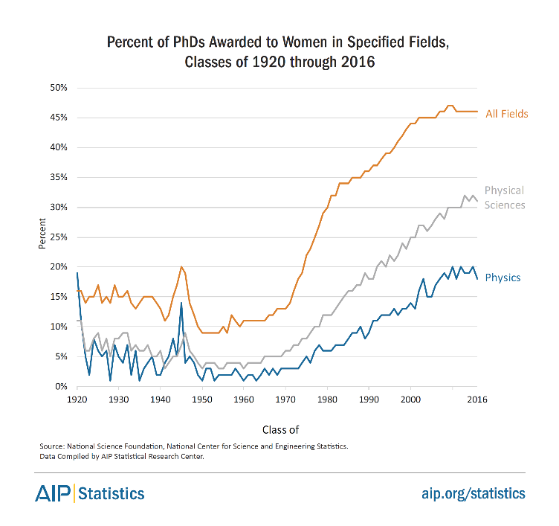

Slide 17
“Microaggressions” and “Subtle Acts of Exclusion”
What are your thoughts on the following statements?
1) “You should have learned this in your baby level Quantum Mechanics”
2) “Why don’t more people like you do physics?”
3) “Your name is interesting. I have never met a person with a name like that. How were you able to make it here?

Slide 18
When to get help:
Even innocent situations can escalate beyond awkward conversations.
If anyone is repeatedly making you uncomfortable and testing your boundaries, you should ask for help.

Slide 19
Where to get help:
UK Campus police
https://www.uky.edu/police/
Emergency 911, Non-Emergency (859) 257-8573
“LiveSafe” App
Office of Equity and Equal Opportunity
https://www.uky.edu/eeo/
(859) 257-8927 AskEO@email.uky.edu
Violence Intervention and Prevention Center (VIP)
https://www.uky.edu/vipcenter/
(859) 257-3574 vipcenter@uky.edu
REU director - Dr. Crawford (cbcraw2@g.uky.edu)
Department Chair – Dr. Plaster (brad.plaster@uky.edu)
Associate Chair - Dr. Murthy (murthy@g.uky.edu)
Dr. Brown (max.brown@uky.edu)
Dr. Ankrah (maxwell.Ankrah@uky.edu)
Emergency:
Formal complaints & Investigations:
Trained Confidential Resources
Understand Physics, however
Mandatory Reporters

